Slide 1
Capstone Project
Presented by - Bhargav Kulkarni
Batch no – 96
Topic – Big Basket data analysis and prescriptive
modelling

Slide 2
CHAPTER -1 Executive Summary

Slide 3
Executive summary
Now a days technology and standard of living changing due to every industry generates huge data in any form like reviews, feedback, facts, information, observation , transactions etc. so every company needs data analysis , deep learning , machine learning, artificial intelligence to predictive modelling this helps every organization to take future decisions and avoid losses.
Now world becoming technology hub in every sector due to data analysis and machine learning , artificial intelligence. This project focuses on data analysis , machine learning predictive models of Big basket (e-commerce industry).

Slide 4
CHAPTER - 2 Industry and Company Profile

Slide 5
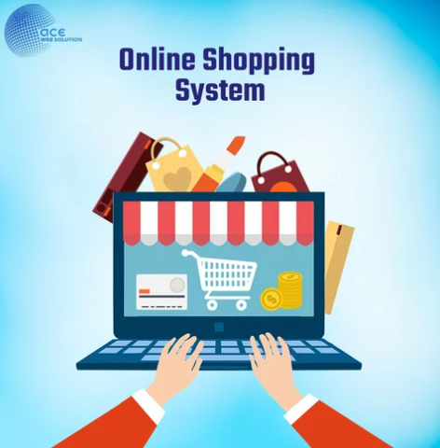
About Industry
E-commerce industry -
e- commerce is buying and selling of goods through online platforms like website, e-commerce apps etc.
now a days maximum customers moving towards
digitalization for every purpose like business,
financial transactions etc.
so e-commerce sector is booming now a days
Example : Big basket , Amazon , Flipkart, Myntra,
Zepto etc.

Slide 6

About bigbasket
bigbasket is India largest online food and grocery store with over 18,000 products and over 1000 brands.
We can find anything like vegetables, fruits, beauty
products, personal items. bigbasket delivers any
products , fruits, vegetables ,beauty products,
personal items within 10-15 minutes to doorstep of
customer. It presents in many metropolitan cities
like Bangalore, Pune, Hyderabad, Mumbai, Nagpur, Delhi etc in so many tier 1 cities in India.

Slide 7
CHAPTER – 3 Theoretical Framework

Slide 8
Theoretical Framework
Introduction -
the data analysis is important to every company to analyse the data with statistics functions and cleaning the data finally visualize the data properly by charts, graphs that helps to understand the data for non technical people.
The data analysis is focuses on descriptive analysis it explains what happen in historical data and diagnostic analysis is why it happen in data this will be understand by exploratory data analysis and statistics functions in python and visualize the data by matplotlib, seaborn, plotly etc.
Data science focuses on predictive analysis and prescriptive analysis predictive analysis means what is going to happen in future that will be understand by machine learning algorithms and visualizations by matplotlib, seaborn, plotly etc. and prescriptive analysis is all about actions or decisions need to be taken in future.

Slide 9
Continued :
Meaning of data analysis -
the data analysis is a process of descriptive and diagnostic analysis which involves data sorting through structured query language queries and removing duplicates, null values and handle null values with statistical tools like mean , median, mode and visualize the data by matplotlib, seaborn ,plotly generate the reports by these visualization tools in Python or R or any programming languages.
Meaning of data science –
the data science is a technique which helps to predictive and prescriptive analysis of data by deep learning, machine learning , artificial intelligence algorithms to take decisions. in future.

Slide 10
Process of data Science
Identify the business problem
Data collection
Exploratory data analysis ( removing duplicates, null values , clean the data)
Data munging
Plan and build the machine learning model
Check the accuracy of predicted data and visualize the data

Slide 11
CHAPTER – 4 Research Methodology

Slide 12
Data collection sources
Primary data collection sources –
Data collected from data scientist dr.dipti (internal mentor)
Data collected from data scientist Akanksha Sharma (external mentor)
Secondary data collection sources —
Data collected from Kaggle

Slide 13
Problem Statement –
the bigbasket is online food and grocery delivery app this has null values in data collected so this bigbasket data required to clean the data and visualize the data for descriptive analysis and build predictive regression models for sale price by training size 60% and check the accuracy of different regression models and suggest the company what are necessary actions need to be taken in future based on predicted data of highest accuracy model.
Objectives of the study –
To clean the data for predictive modelling
To analyse the rating of different categories of products to take necessary actions on low rated product categories.
To analyse the data by matplotlib, seaborn, plotly visualizations to understand which product categories has more sale price and rating.
To take necessary actions on sale price in future it means understanding of whether sale price increases or decreases.

Slide 14
Chapter – 5 Data Analysis and Interpretation

Slide 15
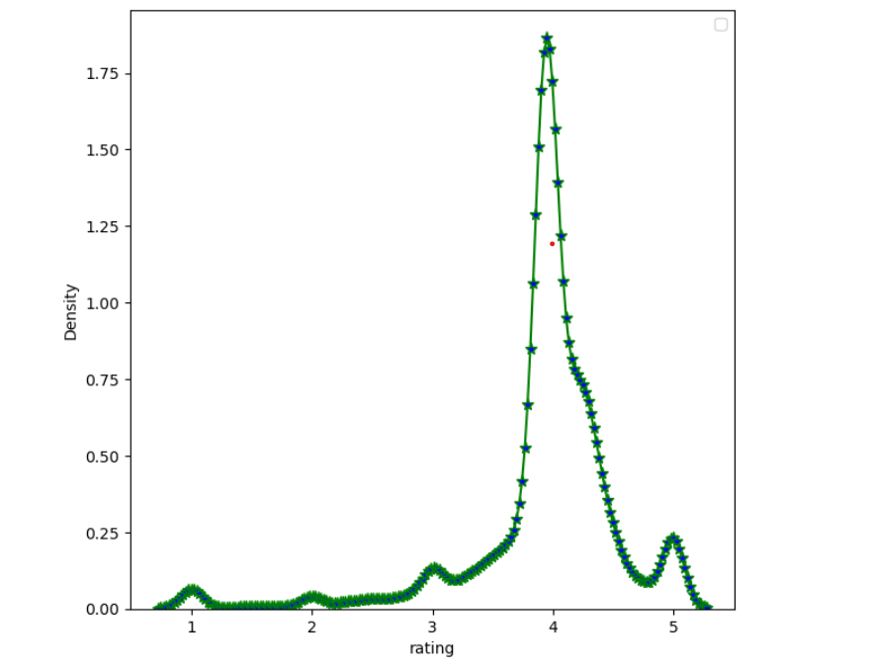
bigbasket rating
Interpretation –
the above diagram of bigbasket rating indicates the rating levels of customers the rating between 3 to 5 is high number of rating it meaning its good rating many people given 4 rating out of 5.

Slide 16
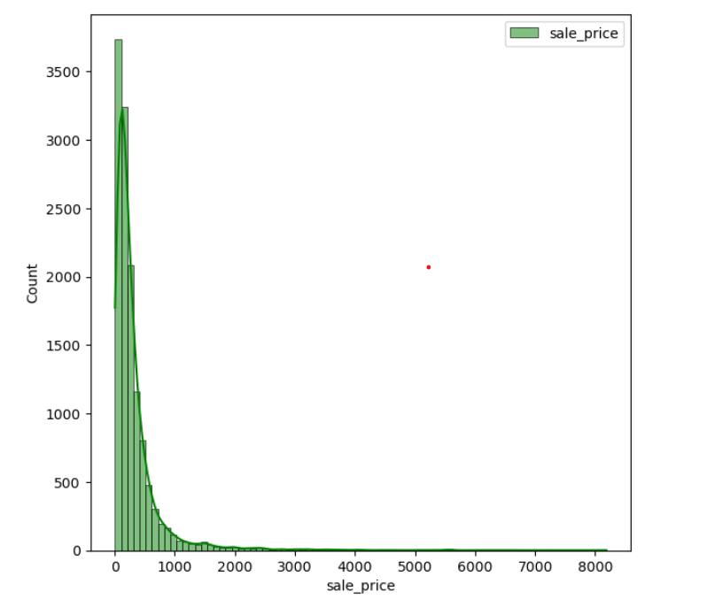
bigbasket sale price
Interpretation –
The above diagram explains the sale price of bigbasket the sale price maximum goes more than 8000 its good. Customers buys vegetables (small purchases) to fruits, costly necessary items.

Slide 17
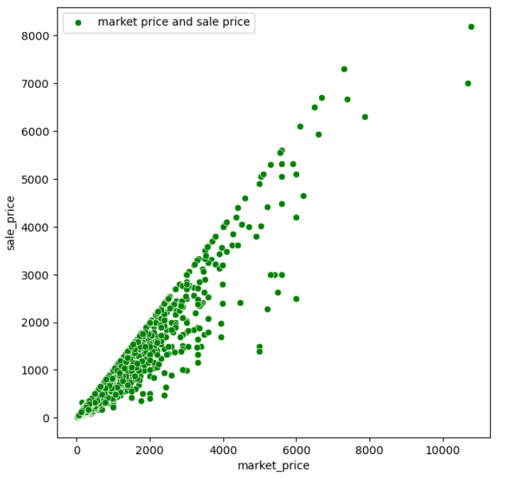
bigbasket Market price and sale price
Interpretation –
The above diagram indicates market price and sale price of bigbasket products here market price is higher that is more than 10,000 but sale price is between 8,000 to 9,000 its good and benefit to consumers.

Slide 18
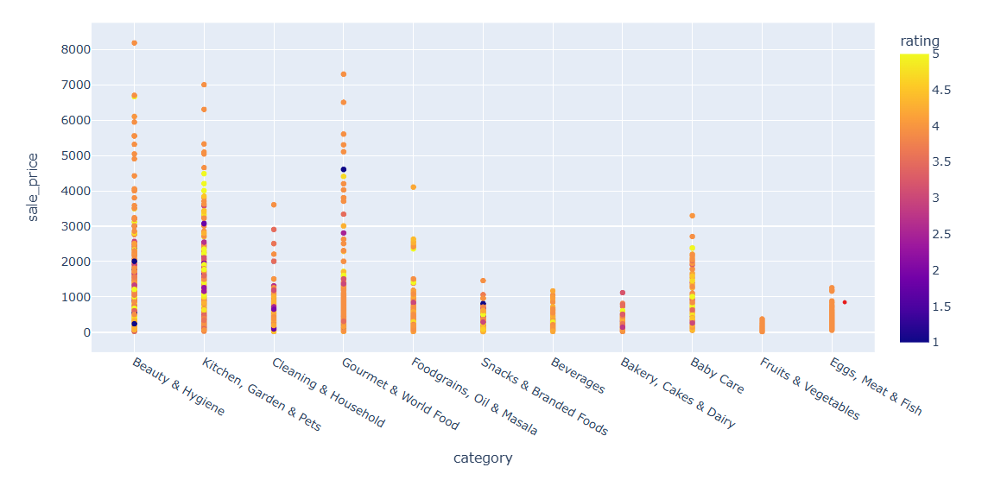
bigbasket Sale price of product categories
Interpretation –
The above diagram explains the category wise sale price and rating color here beauty and hygiene products has more sale price that fall between 8,000 to 9,000 and yellow,orange rating indicates good rating to products.

Slide 19
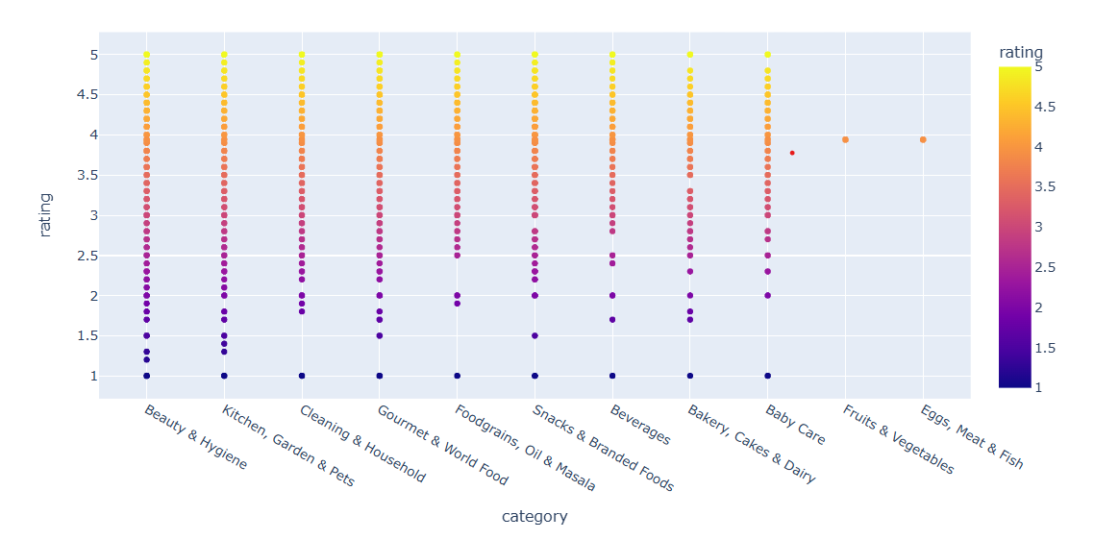
bigbasket Rating of product categories
Interpretation –
The above diagram indicates rating of product categories 5 is highest rating and 1 is lowest rating in this diagram beauty and hygiene ,gourmet & world wood ,kitchen , garden and pets products has highest 5 ratings.

Slide 20
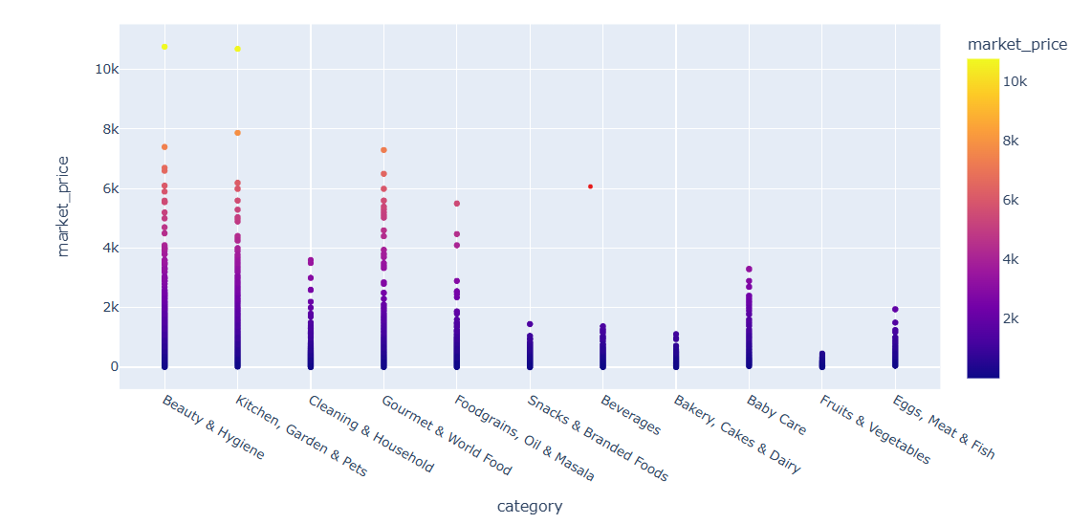
Market price of product categories
Interpretation –
The above diagram explains category wise market price here beauty and hygiene products , kitchen , garden& pets has more market price compare to all categories.

Slide 21
Chapter -6 Descriptive Analysis

Slide 22
Findings and suggestions
Findings –
The bigbasket rating of product categories good the rating fall between 3 to 5 and maximum many customers given 4 rating its good.
The bigbasket offers discounts to customer because the sale price is lesser than market price its good strategy to attract customers.
The bigbasket has highest 5 star ratings for beauty and hygiene products , gourmet & world food, kitchen, garden& pets items has highest ratings.
The bigbasket offers so many categories of products that provides convenience to customers at any time.

Slide 23
Suggestions –
The bigbasket highest sale price is beauty and hygiene products so bigbasket they to buy more beauty and hygiene products and also try to increase sale value of vegetables, bakery items by promotion strategies like discounts, quality of vegetables ,bakery items, beverages etc.
The bigbasket has more 5 star ratings on beauty and hygiene products, gourmet and world food so bigbasket maintains good quality ,reputation ,customer satisfaction of these products much.
The bigbasket should give recommendations of beauty and hygiene products, gourmet & world products because it has highest number of rating to similar customers.

Slide 24
CHAPTER – 7 Prescriptive Analysis

Slide 25
Prescriptions –
In machine learning algorithms Linear Regression given more accuracy 94% so sale price predicted value near to actual value.
In Linear regression predicted sale price is also good like historical data sale price to make profit but if cost like transportation ,tax , product manufacturing input cost, logistics cost generally increases bigbasket also increase sale price based on this cost. But try to give more discounts to avoid these increased cost in the minds of customers.
The linear regression predicted sale price is good so bigbasket increases profit by these sale prices it may take decisions to expend to other cities.

Slide 26
Conclusion –
The bigbasket is largest online food and grocery delivery store with main objective of providing satisfaction to customer by online delivery of any products along with own profit.
The bigbasket now delivers more than 18,000 products with over 1,000 brands in different metropolitan cities of India this contributes to Indian economy , GDP rate , growth in e-commerce industry. This is one of the most necessary online app to customer now a days.

Slide 27
Annexure
GitHub link –
Python-Machine-Learning-Capstone-Capstone-Project/Python Machine Learning Capstone Project .ipynb at main · bhargavkulkarni-code/Python-Machine-Learning-Capstone-Capstone-Project · GitHub

